Slide 1
Facility Layout
Exploring Business: Chapter 11.2

Slide 2
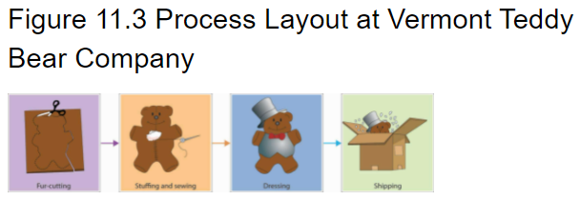
Process Layout
Groups together workers or departments that perform similar tasks. At each position, workers use specialized equipment to perform a particular step in the production process.

Slide 3
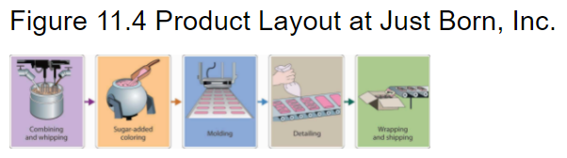
Product Layout
High-volume goods are produced in assembly-line fashion—that is, a series of workstations at which already-made parts are assembled.

Slide 4
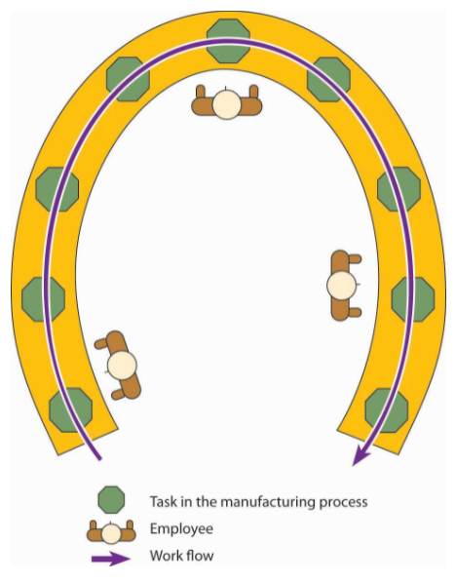
Cellular Layout
Small teams of workers handle all aspects of building a component, a “family of components,” or even a finished product.

Slide 5
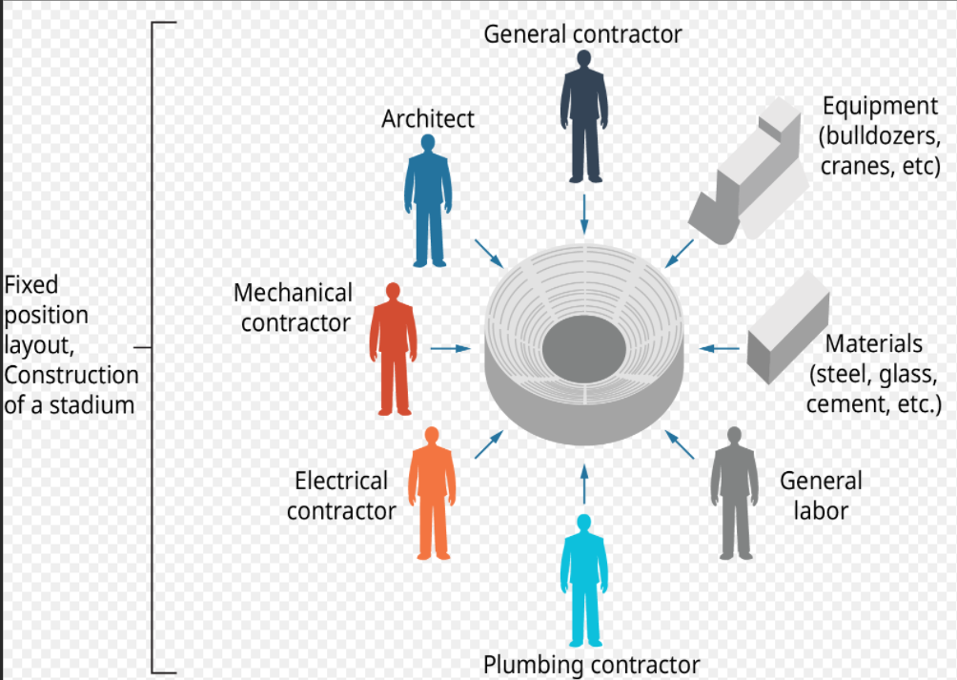
Fixed-Position Layout
Used to make large items (such as ships or buildings) that stay in one place while workers and equipment go to the product.

